Slide 1
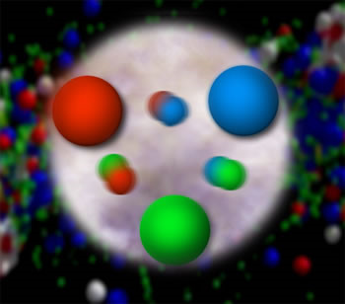

Spin-Momentum Correlations, Aharonov-Bohm, and
Color Entanglement in Quantum Chromodynamics
Christine A. Aidala
University of Michigan
left
right
CENPA Seminar
University of Washington
February 1, 2018

Slide 2
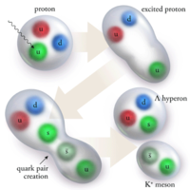
Theory of strong nuclear interaction:
Quantum Chromodynamics
  Fundamental field theory in hand since the early 1970s—BUT . . .
  Quark and gluon degrees of freedom in the theory cannot be observed or manipulated directly in experiment!
Color confinement—quarks and gluons are confined to color-neutral bound states
CLAS, PRL 113, 152004 (2014)
PRL Editor’s Choice Oct. 2014

Slide 3
How do we understand the visible matter in our universe in terms of the quark and gluon degrees of freedom of quantum chromodynamics?
How can studying QCD systems teach us more about fundamental aspects of QCD as a theory?
Notes:
Goals of all of QCD research

Slide 4
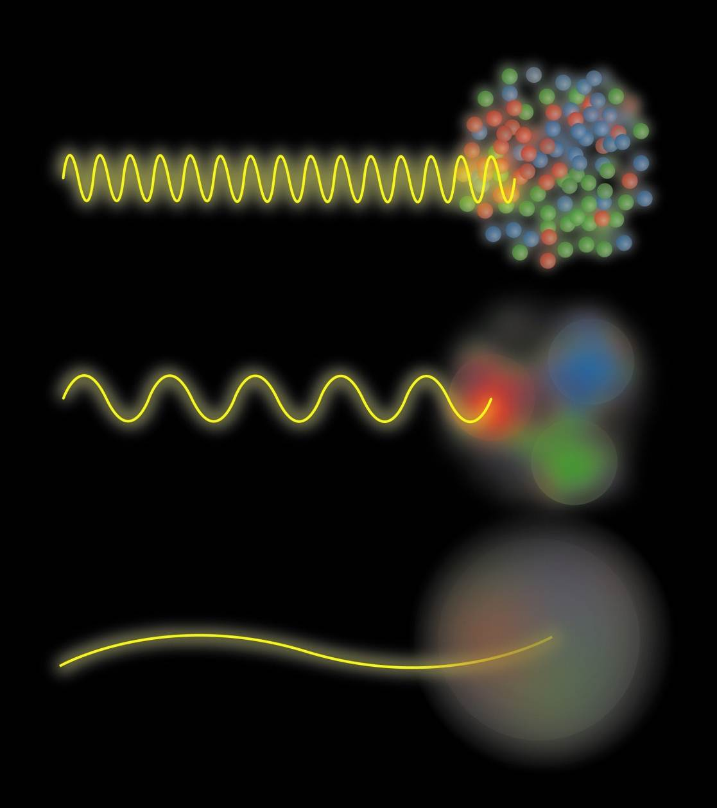
The proton as a “laboratory” for studying QCD
Proton: simplest stable QCD bound state
Different energy scales offer information on different aspects of proton internal structure
Josh Rubin

Slide 5
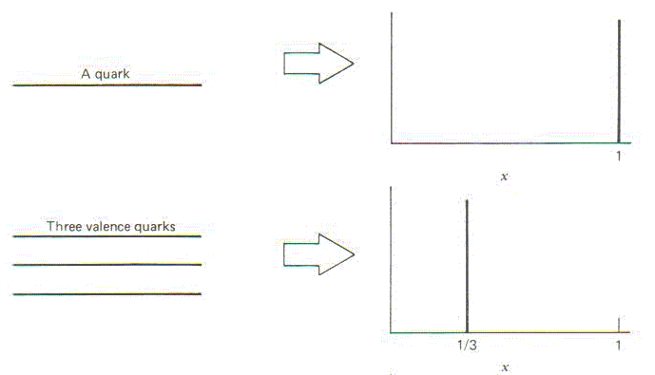
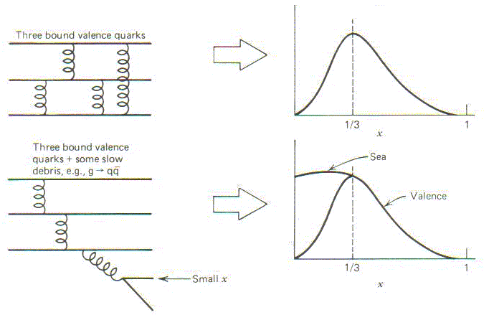
Quark distribution functions inside the proton:
The language we’ve developed (so far!)
What momentum fraction would the scattering particle carry
if the proton were made of …
A point-like
particle
3 bound valence quarks
1
3 bound valence quarks + some
low-momentum sea quarks
1/3
1
momentum fraction
momentum fraction
Sea
3 valence quarks
Valence
small
momentum
1/3
1
1/3
1
momentum fraction
momentum fraction
Halzen and Martin, “Quarks and Leptons”, p. 201

Slide 6
Quark distribution functions inside the proton:
The language we’ve developed (so far!)
What momentum fraction would the scattering particle carry
if the proton were made of …
A point-like
particle
3 bound valence quarks
1
3 bound valence quarks + some
low-momentum sea quarks
1/3
1
momentum fraction
momentum fraction
Sea
3 valence quarks
Valence
small
momentum
1/3
1
1/3
1
momentum fraction
momentum fraction
Halzen and Martin, “Quarks and Leptons”, p. 201

Slide 7
Quark distribution functions inside the proton:
The language we’ve developed (so far!)
What momentum fraction would the scattering particle carry
if the proton were made of …
A point-like
particle
3 bound valence quarks
1
3 bound valence quarks + some
low-momentum sea quarks
1/3
1
momentum fraction
momentum fraction
Sea
3 valence quarks
Valence
small
momentum
1/3
1
1/3
1
momentum fraction
momentum fraction
Halzen and Martin, “Quarks and Leptons”, p. 201

Slide 8
Quark distribution functions inside the proton:
The language we’ve developed (so far!)
What momentum fraction would the scattering particle carry
if the proton were made of …
A point-like
particle
3 bound valence quarks
1
3 bound valence quarks + some
low-momentum sea quarks
1/3
1
momentum fraction
momentum fraction
Sea
3 valence quarks
Valence
small
momentum
1/3
1
1/3
1
momentum fraction
momentum fraction
Halzen and Martin, “Quarks and Leptons”, p. 201

Slide 9
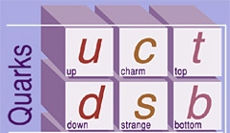
What have we learned in terms of this picture by now?
Up and down quark “valence” distributions peaked ~1/3
Lots of sea quark-antiquark pairs and even more gluons!
distribution function
momentum fraction
PRD67, 012007 (2003)

Slide 10
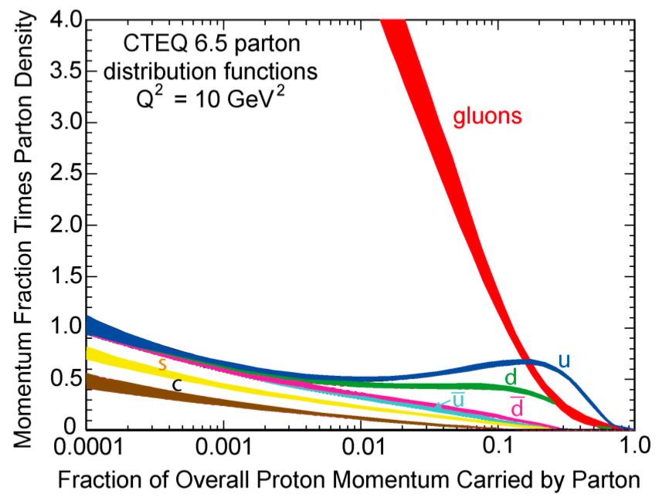
What have we learned in terms of this picture by now?
Up and down quark “valence” distributions peaked ~1/3
Lots of sea quark-antiquark pairs and even more gluons!
parton distribution function
momentum fraction
PRD67, 012007 (2003)

Slide 11
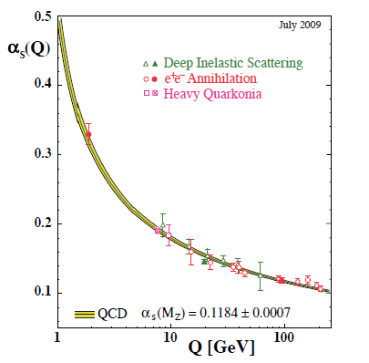
Perturbative QCD
Take advantage of running of strong coupling constant with energy (asymptotic freedom)—weak coupling at high energies (short distances)
Perturbative expansion as in quantum electrodynamics (but many more diagrams due to gluon self-coupling!!)
Notes:
Scattering energy

Slide 12
Perturbative QCD
Take advantage of running of strong coupling constant with energy (asymptotic freedom)—weak coupling at high energies (short distances)
Perturbative expansion as in quantum electrodynamics (but many more diagrams due to gluon self-coupling!!)
Provides one rigorous way of relating the fundamental field theory to a variety of physical observables!
Notes:
Scattering energy

Slide 13
Factorization and universality in perturbative QCD
Systematically factorize short- and long-distance physics
  Observable physical QCD processes always involve at least one “long-distance” scale of ~10⁻¹⁵ m describing bound-state structure (confinement)!
Long-distance (i.e. not perturbatively calculable) functions describing structure need to be universal
  Physically meaningful descriptions
  Portable across calculations for many processes
Constrain functions describing proton structure by measuring scattering cross sections in many colliding systems over wide kinematic range and performing
simultaneous fits to world data

Slide 14
Factorization and universality in perturbative QCD
Systematically factorize short- and long-distance physics
  Observable physical QCD processes always involve at least one “long-distance” scale of ~10⁻¹⁵ m describing bound-state structure (confinement)!
Long-distance (i.e. not perturbatively calculable) functions describing structure need to be universal
  Physically meaningful descriptions
  Portable across calculations for many processes
Note: Nonperturbative lattice QCD techniques have made tremendous progress toward ab initio calculations of proton structure in last ~5 years!
Constrain functions describing proton structure by measuring scattering cross sections in many colliding systems over wide kinematic range and performing
simultaneous fits to world data

Slide 15
Mapping out the quark-gluon structure of the proton
What does the proton look like in terms of the quarks and gluons inside it?
Position
Momentum
Spin
Flavor
Color
Vast majority of past four decades focused on
1-dimensional momentum structure! Since 1990s starting to consider transverse components . . .

Slide 16
Mapping out the quark-gluon structure of the proton
What does the proton look like in terms of the quarks and gluons inside it?
Position
Momentum
Spin
Flavor
Color
Polarized protons first studied in 1980s. How angular momentum of quarks and gluons add up still not well understood!

Slide 17
Mapping out the quark-gluon structure of the proton
What does the proton look like in terms of the quarks and gluons inside it?
Position
Momentum
Spin
Flavor
Color
Good measurements of flavor distributions in valence region. Flavor structure at lower momentum fractions still yielding surprises!

Slide 18
Mapping out the quark-gluon structure of the proton
What does the proton look like in terms of the quarks and gluons inside it?
Position
Momentum
Spin
Flavor
Color
Theoretical and experimental concepts to describe and access position only born in mid-1990s. Pioneering measurements over past decade.

Slide 19
Mapping out the quark-gluon structure of the proton
What does the proton look like in terms of the quarks and gluons inside it?
Position
Momentum
Spin
Flavor
Color
Accounted for theoretically from beginning of QCD, but more detailed, potentially observable effects of color flow have come to forefront in last few years . . .

Slide 20
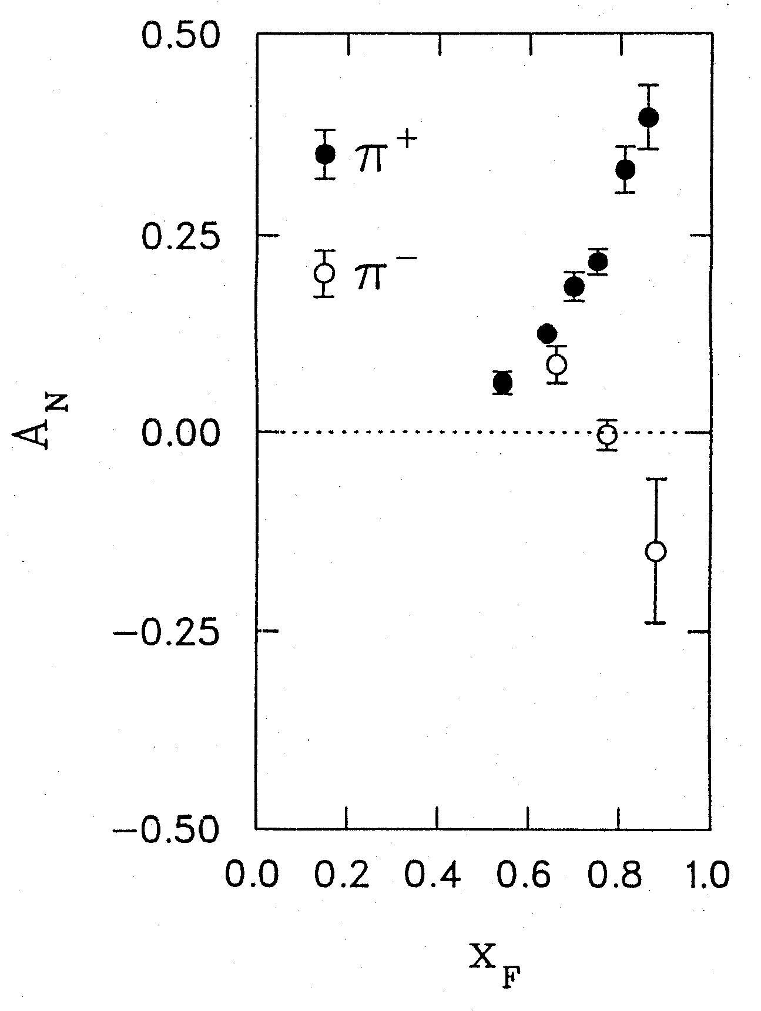
Spin-momentum correlations:
1976 discovery in p+p collisions
Argonne √s=4.9 GeV
Charged pions produced preferentially on one or the other side with respect to the transversely polarized beam direction—by up to 40%!!
Had to wait more than a decade for the birth of a new subfield in order to explore the possibilities . . .
left
right
W.H. Dragoset et al., PRL36, 929 (1976)

Slide 21
Transverse-momentum-dependent distributions and single-spin asymmetries
1990: D.W. Sivers departs from traditional collinear factorization assumption in pQCD and proposes correlation between the intrinsic transverse motion of the quarks and gluons and the proton’s spin
Spin and momenta of quarks and/or bound states
D.W. Sivers
PRD41, 83 (1990)
Notes:
Dennis Sivers motivated by forthcoming E704 data

Slide 22
Transverse-momentum-dependent distributions and single-spin asymmetries
1990: D.W. Sivers departs from traditional collinear factorization assumption in pQCD and proposes correlation between the intrinsic transverse motion of the quarks and gluons and the proton’s spin
First quark distribution function describing a spin-momentum correlation in the proton
Spin and momenta of quarks and/or bound states
D.W. Sivers
PRD41, 83 (1990)
Notes:
Dennis Sivers motivated by forthcoming E704 data

Slide 23
Transverse-momentum-dependent distributions and single-spin asymmetries
1990: D.W. Sivers departs from traditional collinear factorization assumption in pQCD and proposes correlation between the intrinsic transverse motion of the quarks and gluons and the proton’s spin
First quark distribution function describing a spin-momentum correlation in the proton
New frontier! Quark dynamics inside QCD bound states, and in their formation process
Spin and momenta of quarks and/or bound states
D.W. Sivers
PRD41, 83 (1990)
Notes:
Dennis Sivers motivated by forthcoming E704 data

Slide 24
Spin-spin and spin-momentum correlations in QCD bound states
Unpolarized
Spin-spin correlations
Spin-momentum correlations

Slide 25
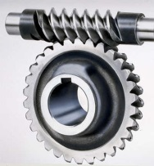

Spin-spin and spin-momentum correlations in QCD bound states
Worm-gear
(Kotzinian-Mulders)
Unpolarized
Spin-spin correlations
Helicity
Transversity
Sivers
Spin-momentum correlations
Boer-Mulders
Pretzelosity
Worm-gear

Slide 26
Spin-spin and spin-momentum correlations in QCD bound states
Worm-gear
(Kotzinian-Mulders)
Unpolarized
Spin-spin correlations
Helicity
G.A. Miller, Phys. Rev. C68,
022201 (2003)
Transversity
Sivers
Spin-momentum correlations
Boer-Mulders
Pretzelosity
Worm-gear

Slide 27
Spin-spin and spin-momentum correlations in QCD bound states
Worm-gear
(Kotzinian-Mulders)
Unpolarized
Spin-spin correlations
Helicity
Lots of evidence from deep-inelastic lepton-nucleon scattering experiments over past ~12 years that many of these correlations are nonzero in nature!
Transversity
Sivers
Spin-momentum correlations
Boer-Mulders
Pretzelosity
Worm-gear

Slide 28
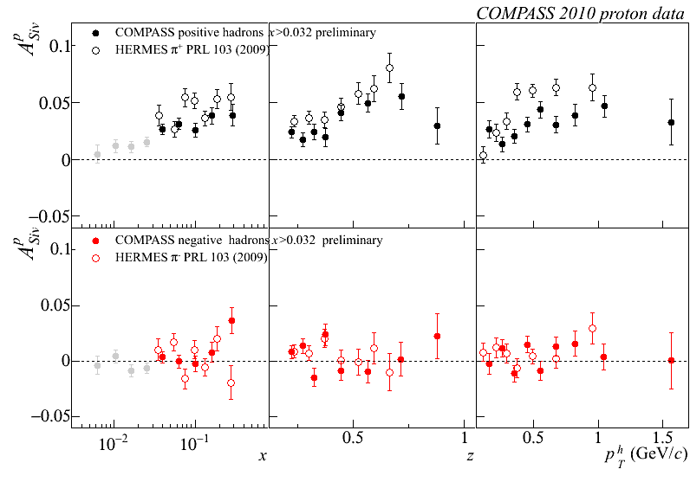
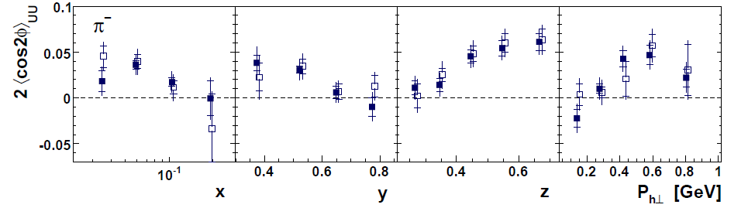
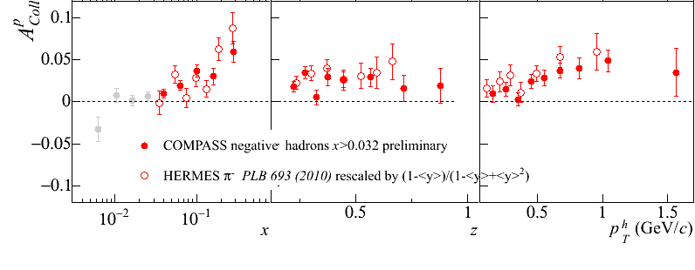
Sivers
e+p
μ+p
Boer-Mulders x Collins
e+p
HERMES, PRD 87, 012010 (2013)
e+p
μ+p
Transversity x Collins

Slide 29
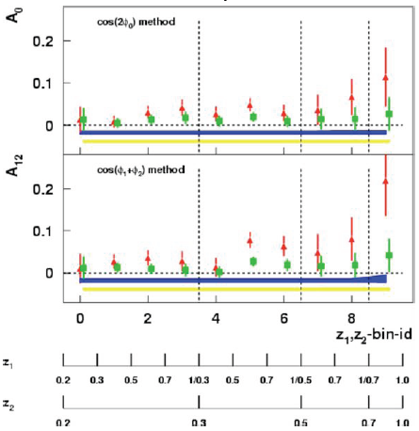
Sivers
e+p
μ+p
BELLE PRL96, 232002 (2006)
Collins x Collins
e⁺e⁻
Boer-Mulders x Collins
e+p
HERMES, PRD 87, 012010 (2013)
e+p
μ+p
Transversity x Collins

Slide 30
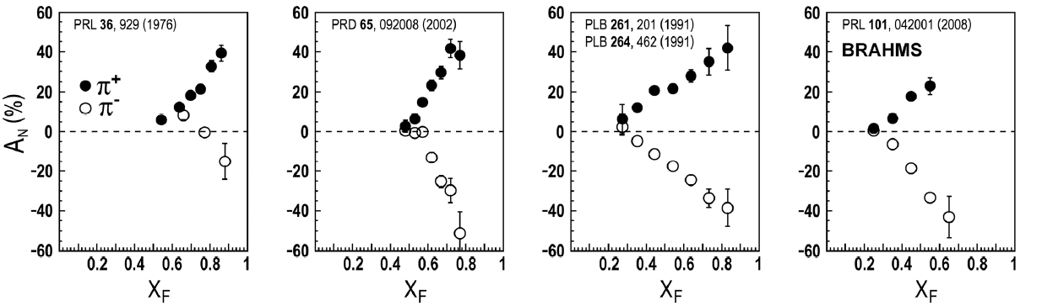
But what about proton-proton collisions?
ANL
√s=4.9 GeV
BNL
√s=6.6 GeV
FNAL
√s=19.4 GeV
RHIC
√s=62.4 GeV
Aidala, Bass, Hasch, Mallot, RMP 85, 655 (2013)
left
right

Slide 31
But what about proton-proton collisions?
ANL
√s=4.9 GeV
BNL
√s=6.6 GeV
FNAL
√s=19.4 GeV
RHIC
√s=62.4 GeV
Aidala, Bass, Hasch, Mallot, RMP 85, 655 (2013)
left
Much larger spin-momentum correlations, and strikingly similar effects across energies!
right

Slide 32
Single-spin asymmetries in transversely polarized proton-proton collisions
A_{N} x_{F} = 0.6
A_{N}
STAR
π⁰
Effects persist to kinematic regimes where perturbative QCD techniques clearly apply
left
p_{T} GeV/c
right

Slide 33
proton-proton → pion + X:
Challenging to interpret
Always huge effects!
But in p+p → pion +X don’t have enough information to separate initial-state (proton structure) from final-state (pion formation) effects
Need to think more carefully . . .

Slide 34
Different symmetry properties for different spin-momentum correlations
Some transverse-momentum-dependent parton distribution functions odd under a parity- and time-reversal (PT) transformation
In 1993, after original 1990 paper by D.W. Sivers, J.C. Collins claimed such functions must vanish
Only realized in 2002 by Brodsky, Hwang, and Schmidt that could be nonvanishing if phase interference effects due to color interactions present

Slide 35
Different symmetry properties for different spin-momentum correlations
Some transverse-momentum-dependent parton distribution functions odd under a parity- and time-reversal (PT) transformation
In 1993, after original 1990 paper by D.W. Sivers, J.C. Collins claimed such functions must vanish
Only realized in 2002 by Brodsky, Hwang, and Schmidt that could be nonvanishing if phase interference effects due to color interactions present

Slide 36
Different symmetry properties for different spin-momentum correlations
Some transverse-momentum-dependent parton distribution functions odd under a parity- and time-reversal (PT) transformation
In 1993, after original 1990 paper by D.W. Sivers, J.C. Collins claimed such functions must vanish
Only realized in 2002 by Brodsky, Hwang, and Schmidt that could be nonvanishing if phase interference effects due to color interactions present

Slide 37
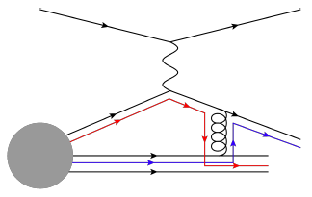
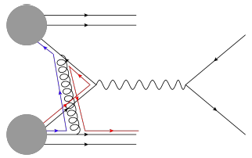
Modified universality of PT-odd correlations:
Color in action!
Deep-inelastic lepton-nucleon scattering: Final-state color exchange
Quark-antiquark annihilation to leptons: Initial-state color exchange
incoming
electron
scattered
electron
incoming proton
proton remnant
produced
positron
scattering
antiquark
scattering
quark
scattered
quark
scattering
quark
proton remnant
proton remnant
produced
electron
incoming proton
incoming proton
Opposite sign for PT-odd transverse-momentum-dependent distributions measured in these two processes:
process-dependent! (Collins 2002)
Figures by J.D. Osborn

Slide 38

Modified universality:
Initial experimental hints
Predictions including
sign change
}
STAR
PRL 116, 132301 (2016)
PRL 119, 112002 (2017)
First measurements by STAR at RHIC and COMPASS at CERN suggestive of predicted sign change in color-annihilation processes compared to quark knock-out by an electron.
More statistics forthcoming . . .

Slide 39

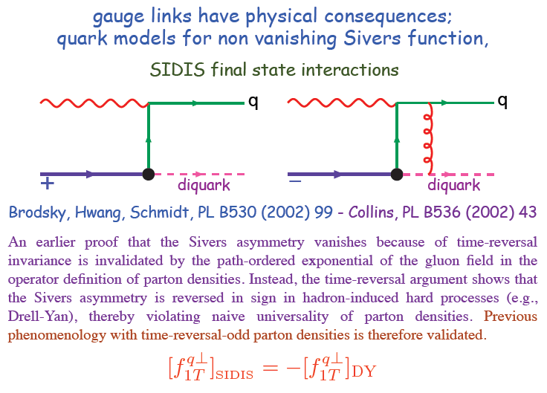
Modified universality requires full QCD:
Gauge-invariant quantum field theory
From 1993 claim by J.C. Collins that such processes must vanish
Slide from M. Anselmino, Transversity 2014

Slide 40
Physical consequences of a gauge-invariant quantum theory:
Aharonov-Bohm (1959)
Wikipedia:
“The Aharonov–Bohm effect is important conceptually because it bears on three issues apparent in the recasting of (Maxwell's) classical electromagnetic theory as a gauge theory, which before the advent of quantum mechanics could be argued to be a mathematical reformulation with no physical consequences. The Aharonov–Bohm thought experiments and their experimental realization imply that the issues were not just philosophical.
The three issues are:
whether potentials are "physical" or just a convenient tool for calculating force fields;
whether action principles are fundamental;
the principle of locality.”

Slide 41
Physical consequences of a gauge-invariant quantum theory:
Aharonov-Bohm (1959)
Physics Today, September 2009 :
The Aharonov–Bohm effects: Variations on a subtle theme,
by Herman Batelaan and Akira Tonomura.
“Aharonov stresses that the arguments that led to the prediction of the various electromagnetic AB effects apply equally well to any other gauge-invariant quantum theory. In the standard model of particle physics, the strong and weak nuclear interactions are also described by gauge-invariant theories. So one may expect that particle-physics experimenters will be looking for new AB effects in new domains.”

Slide 42
Physical consequences of a gauge-invariant quantum theory:
Aharonov-Bohm effect in QCD!!
Deep-inelastic lepton-nucleon scattering: Final-state color exchange
Quark-antiquark annihilation to leptons: Initial-state color exchange
incoming
electron
scattered
electron
incoming proton
proton remnant
produced
positron
scattering
antiquark
scattering
quark
scattered
quark
scattering
quark
proton remnant
proton remnant
produced
electron
incoming proton
incoming proton
See e.g. Pijlman, hep-ph/0604226
or Sivers, arXiv:1109.2521

Slide 43
Physical consequences of a gauge-invariant quantum theory:
Aharonov-Bohm effect in QCD!!
Deep-inelastic lepton-nucleon scattering: Final-state color exchange
Quark-antiquark annihilation to leptons: Initial-state color exchange
incoming
electron
scattered
electron
incoming proton
proton remnant
produced
positron
scattering
antiquark
Simplicity of these two processes:
Abelian vs. non-Abelian nature of the gauge group doesn’t play a role.
BUT: In QCD expect additional, new effects due to specific non-Abelian nature of the gauge group → gluon self-coupling
scattering
quark
scattered
quark
scattering
quark
proton remnant
proton remnant
produced
electron
incoming proton
incoming proton
See e.g. Pijlman, hep-ph/0604226
or Sivers, arXiv:1109.2521

Slide 44
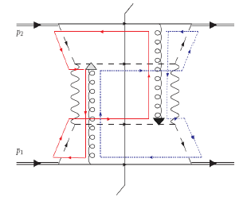
QCD Aharonov-Bohm effect:
Color entanglement
  2010: T.C. Rogers and P. Mulders predict color entanglement in processes involving proton-proton production of QCD bound states if quark transverse momentum taken into account
  Quarks become correlated across the two colliding protons
  Consequence of QCD specifically as a non-Abelian gauge theory!
PRD 81, 094006 (2010)
Color flow can’t be described as flow in the two gluons separately. Requires presence of both.

Slide 45
QCD Aharonov-Bohm effect:
Color entanglement
  2010: T.C. Rogers and P. Mulders predict color entanglement in processes involving proton-proton production of QCD bound states if quark transverse momentum taken into account
  Quarks become correlated across the two colliding protons
  Consequence of QCD specifically as a non-Abelian gauge theory!
PRD 81, 094006 (2010)
Color flow can’t be described as flow in the two gluons separately. Requires presence of both.
Huge transverse spin asymmetries in p+p a color entanglement effect??

Slide 46
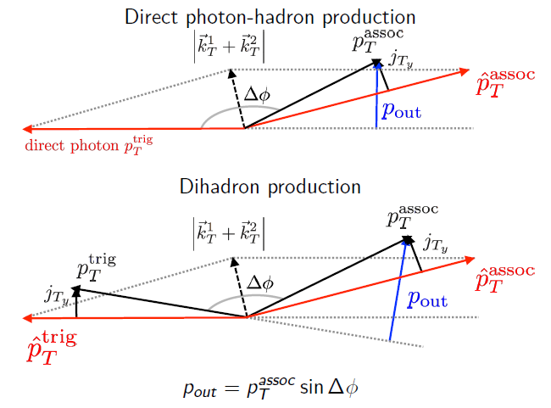
Searching for evidence of color entanglement at RHIC
Need observable sensitive to a nonperturbative momentum scale
  Nearly back-to-back particle production
Need 2 initial QCD bound states
  color exchange between a scattering quark and remnant of other proton
And at least 1 final QCD bound state
  exchange between scattered quark and either remnant
→ In p+p collisions, measure out-of-plane momentum component in nearly back-to-back photon-hadron and hadron-hadron production

Slide 47
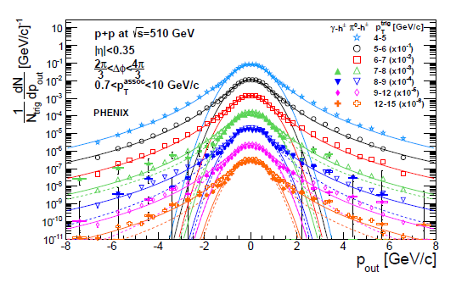
Out-of-plane momentum component distributions
PRD95, 072002 (2017)
Clear two-component distribution
  Gaussian near 0— nonperturbative transverse momentum
  Power-law at large p_{out}—kicks from hard (perturbative) gluon radiation
Different colors → different bins in hard interaction scale
Curves are fits to Gaussian and Kaplan functions, not calculations!

Slide 48
Look at evolution of nonperturbative transverse momentum widths with hard scale (Q²)
Proof of factorization (i.e. no entanglement) for processes sensitive to nonperturbative transverse momentum directly predicts that nonperturbative transverse momentum widths increase as a function of the hard scattering energy scale
  Increased phase space for gluon radiation
Confirmed experimentally in semi-inclusive deep-inelastic lepton-nucleon scattering (left) and quark-antiquark annihilation to leptons (right)

Slide 49
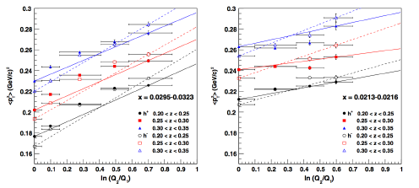
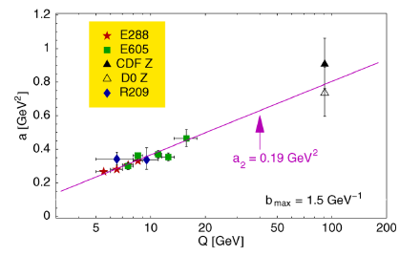
Look at evolution of nonperturbative transverse momentum widths with hard scale (Q²)
Proof of factorization (i.e. no entanglement) for processes sensitive to nonperturbative transverse momentum directly predicts that nonperturbative transverse momentum widths increase as a function of the hard scattering energy scale
  Increased phase space for gluon radiation
Confirmed experimentally in deep-inelastic lepton-nucleon scattering (left) and quark-antiquark annihilation to leptons (right)
Aidala, Field, Gamberg, Rogers, Phys. Rev. D89, 094002 (2014)
Konychev + Nadolsky, Phys. Lett. B633, 710 (2006)

Slide 50
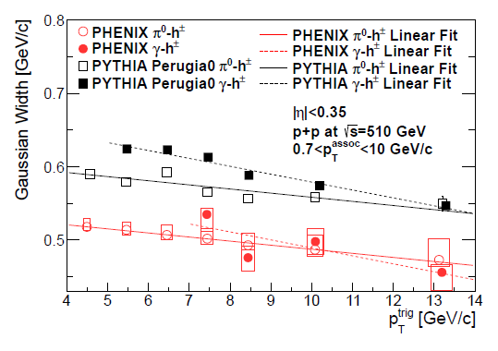
Nonperturbative momentum widths may decrease in processes where entanglement predicted??
Measurements suggestive of quantum-correlated quarks across colliding protons?
However, correlations among measured kinematic variables make results inconclusive …
Follow-up studies underway
PHENIX Collab., PRD95, 072002 (2017)
Discussions of other potential observables ongoing . . .

Slide 51
A cyclical process
Proliferation of observations and ideas
Synthesis
Notes:
After lots of new observations and ideas over the course of the last 15-20 years, we’re now in a rewarding period of synthesis

Slide 52
Summary
Early years of rewarding new era of quantitative basic research in QCD!
Gradually shifting to think about QCD systems in new ways, focusing on topics/ideas/concepts that have long been familiar to the world of condensed matter and AMO physics
  All sorts of correlations within systems and in their formation
  Quantum mechanical phase interference effects
  Quantum entangled systems

Slide 53
Summary
Early years of rewarding new era of quantitative basic research in QCD!
Gradually shifting to think about QCD systems in new ways, focusing on topics/ideas/concepts that have long been familiar to the world of condensed matter and AMO physics
  All sorts of correlations within systems and in their formation
  Quantum mechanical phase interference effects
  Quantum entangled systems

Slide 54
Summary
Early years of rewarding new era of quantitative basic research in QCD!
Gradually shifting to think about QCD systems in new ways, focusing on topics/ideas/concepts that have long been familiar to the world of condensed matter and AMO physics
  All sorts of correlations within systems and in their formation
  Quantum mechanical phase interference effects
  Quantum entangled systems
Will be exciting to continue testing and exploring these ideas and phenomena in upcoming years . . .

Slide 55
Afterword:
QCD “versus” proton structure?
A personal perspective

Slide 56
We shall not cease from exploration
And the end of all our exploring
Will be to arrive where we started
And know the place for the first time.
T.S. Eliot

Slide 57
Extra

Slide 58
Advancing into the era of quantitative QCD: Theory has been forging ahead
In perturbative QCD, since 1990s starting to consider detailed internal dynamics that parts with traditional parton model ways of looking at hadrons—and perform phenomenological calculations using these new ideas/tools!
E.g.:
  Various resummation techniques
  Non-linear evolution at small momentum fractions
  Spin-spin and spin-momentum correlations in QCD bound states
  Spatial distributions of partons in QCD bound states
Nonperturbative methods:
  Lattice QCD less and less limited by computing resources—since 2010 starting to perform calculations at the physical pion mass (after 36 years!). Plus recent new ideas on how to calculate previously intractable quantities.
  AdS/CFT “gauge-string duality” an exciting recent development as first fundamentally new handle to try to tackle QCD in decades!

Slide 59
Effective field theories
QCD exhibits different behavior at different scales—effective field theories are useful approximations within these different regimes
  Color Glass Condensate – high energies, high densities
  Soft-Collinear Effective Theory – new insights into performing complicated perturbative calculations very quickly
  Chiral Effective Theory, Heavy Quark Effective Theory, Non-Relativistic QCD, . . .
  Many effective theories for nonperturbative QCD – chiral symmetry breaking, . . .

Slide 60
Parton distribution functions in perturbative QCD calculations of observables
q(x₁)
Hard Scattering Process
X
g(x₂)
High-energy processes have predictable rates given:
    Partonic hard scattering rates (calculable in pQCD)
    Parton distribution functions (experiment or lattice)
    Fragmentation functions (experiment or lattice)
Universal non-perturbative factors

Slide 61
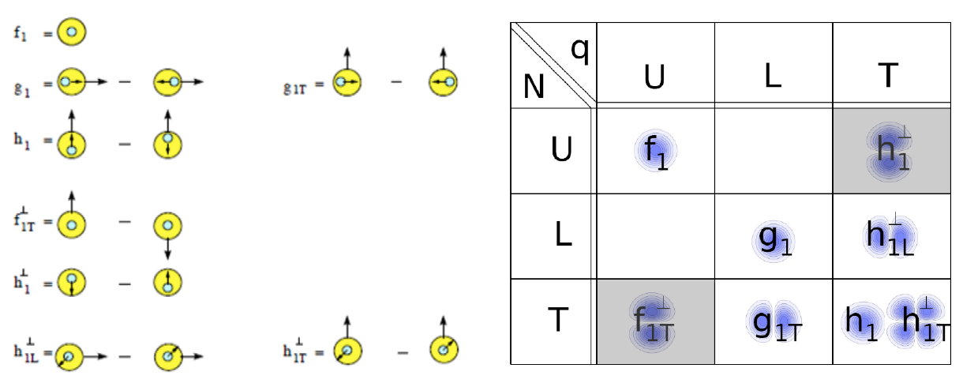
Spin-spin and spin-momentum correlations in QCD bound states
U = unpolarized L = longitudinally polarized T = transversely polarized
N = nucleon q = quark

Slide 62
Forward transverse single-spin asymmetries for neutral pions

Slide 63
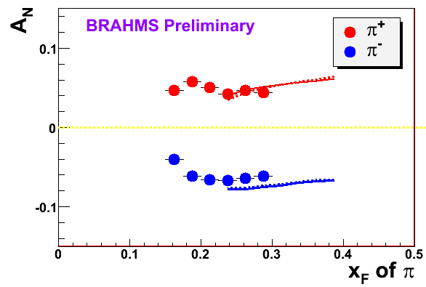
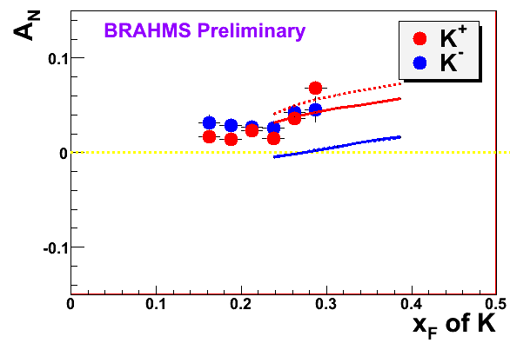

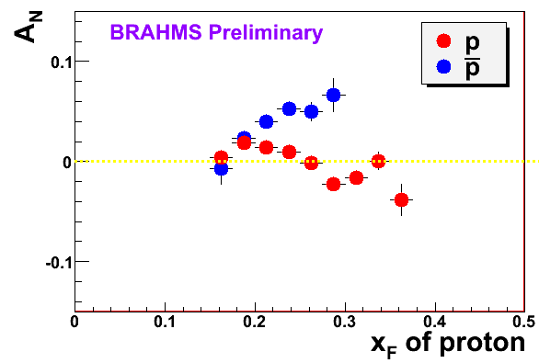
π
π
π, K, p
at 200 and 62.4 GeV
200 GeV
62.4 GeV
Note different scales
K
K
K- asymmetries
underpredicted
Pions suggest valence quark effect.
Kaons and (anti)protons don’t!
200 GeV
62.4 GeV
p
p
PRL 101, 042001 (2008)
Large antiproton asymmetry?? Unfortunately no 62.4
GeV measurement
200 GeV
62.4 GeV

Slide 64
Partonic process contributions for direct photon production
PHENIX data region
Quark-gluon Compton scattering still dominates at NLO -
PLB140, 87 (1984)
PHENIX Collab., arXiv:1609.04769,
Submitted to PRD.
Calculation by T. Kaufmann

Slide 65
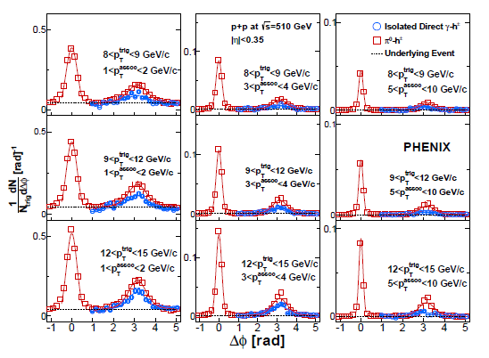
Two-particle correlation distributions show expected jet-like structure
PRD95, 072002 (2017)

Slide 66
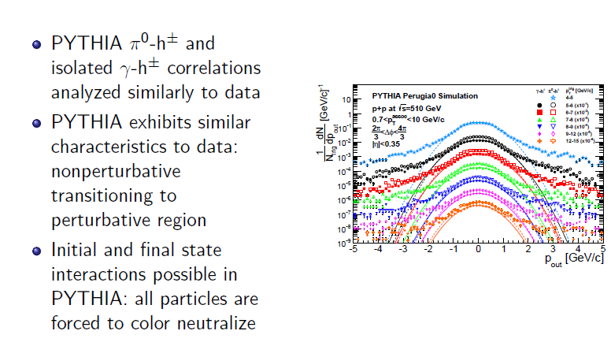
PYTHIA p_{out} distributions

Slide 67
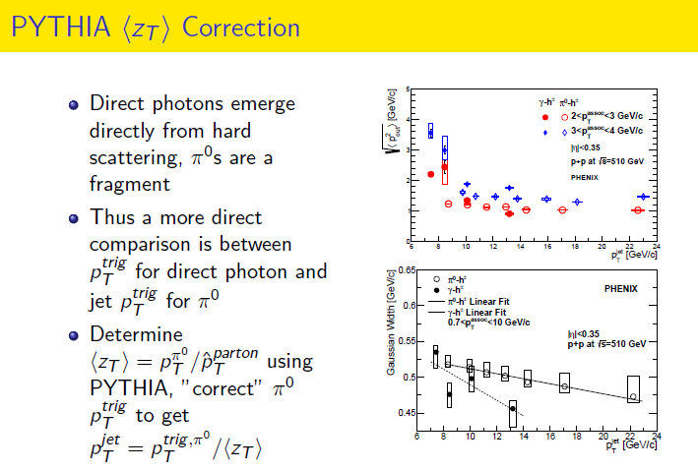

Slide 68
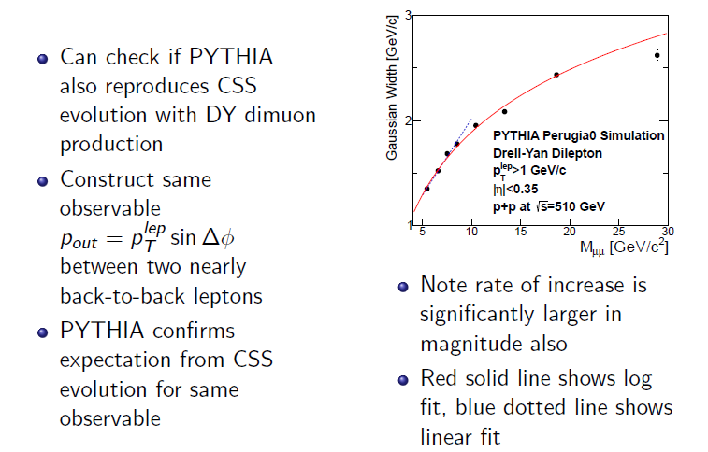
PYTHIA Drell-Yan

Slide 69
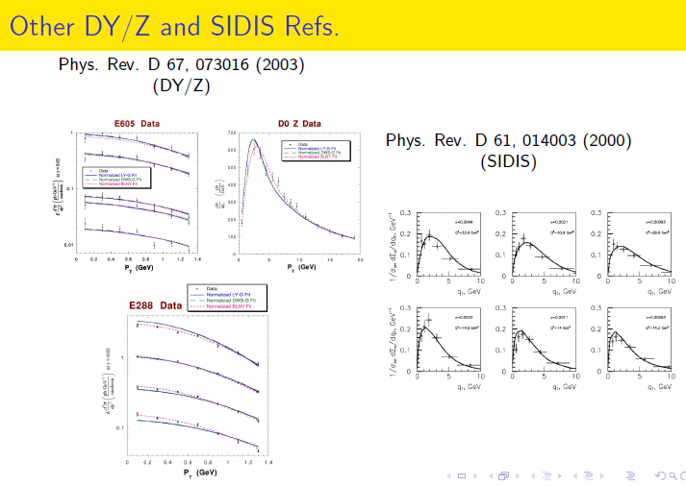
Nonperturbative momentum measurements in Drell-Yan and Z production

Slide 70
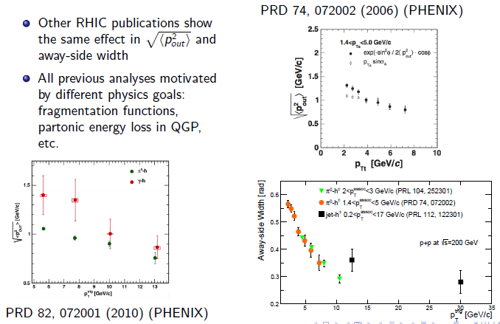
Other measurements showing decreasing nonperturbative momentum widths
STAR and PHENIX

Slide 71
Nuclear effects?
Do stronger color fields lead to modified factorization breaking effects?
p+Au shows steepest decreasing slope for most peripheral events—why??

Slide 72
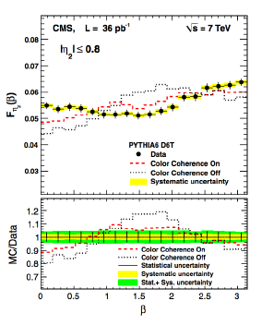
Links to “color coherence” at Tevatron and LHC?
D0, CDF, CMS have all published evidence for “color coherence effects”
  CMS: EPJ C74, 2901 (2014)
  CDF: PRD50, 5562 (1994)
  D0: PLB414, 419 (1997)
Few citations—relatively little-known work thus far. Need to get different communities talking to explore detailed color effects more in upcoming years!

Slide 73
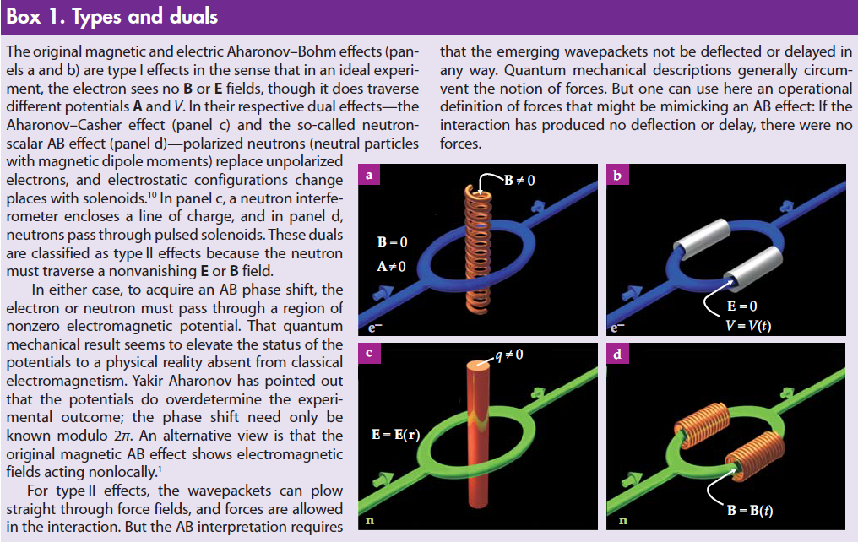
Magnetic and electric A-B effects;
Type-I and Type-II A-B effects
Physics Today, September 2009

Slide 74
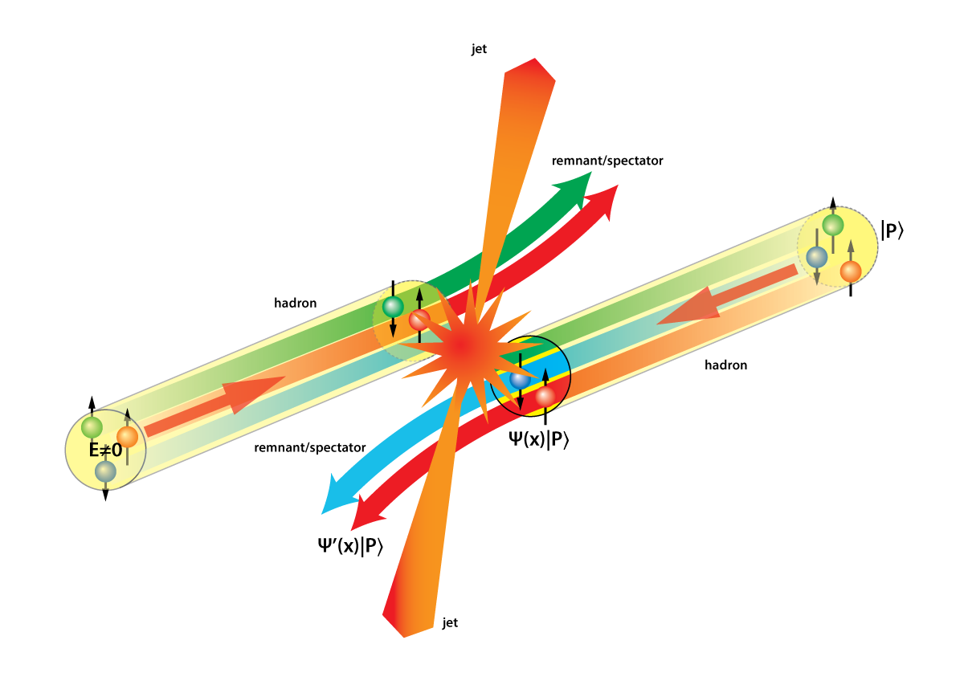
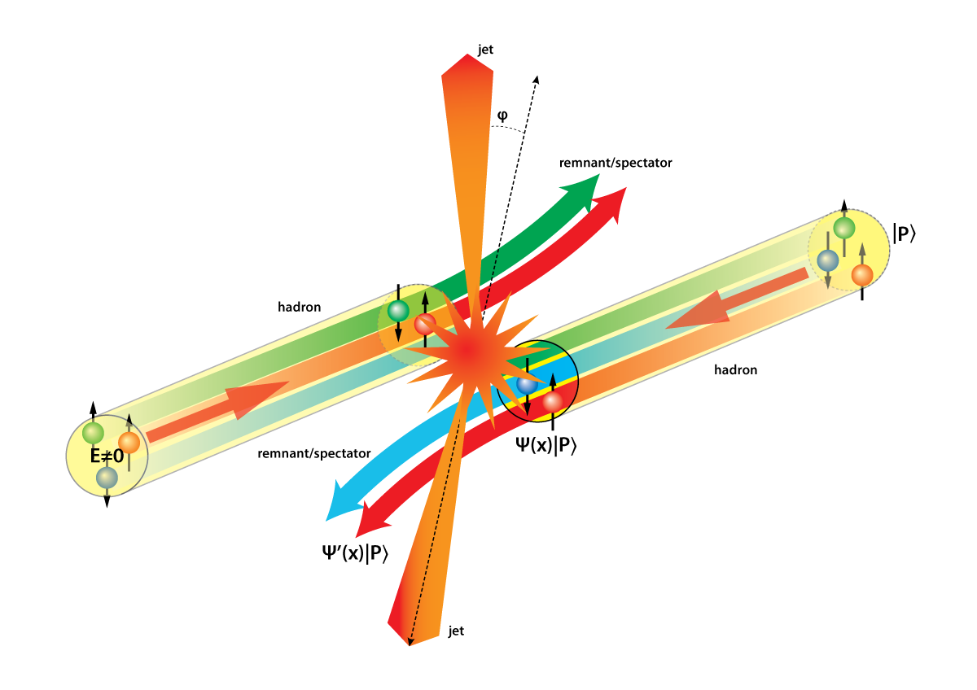
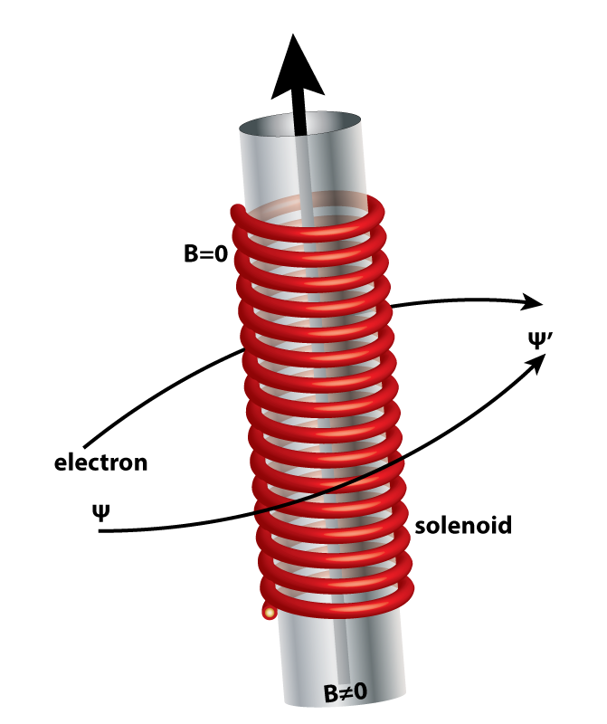
Opportunities to see color-induced phases in QCD
Slide from P. Mulders
Figures by Kees Huyser

